Slide 1

User Manual
SAP - APPROVAL WORKFLOW
User Manual - SAP approval workflow

Slide 2
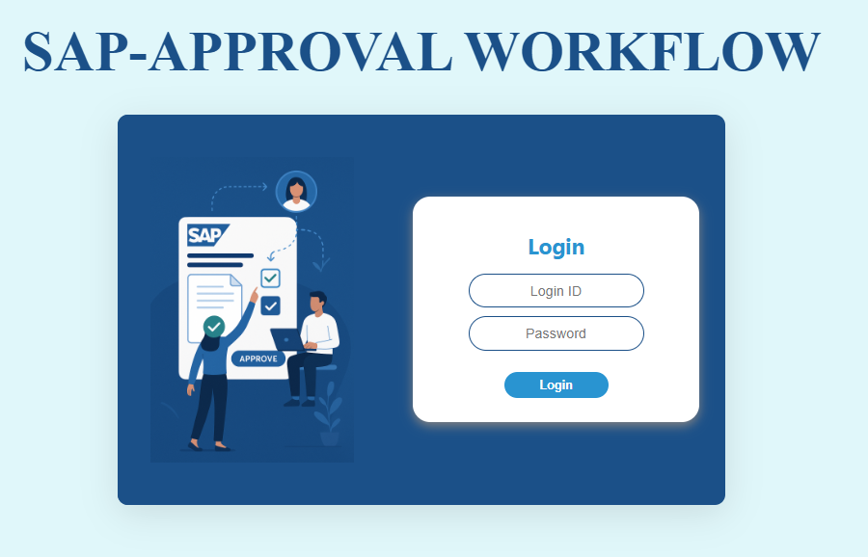
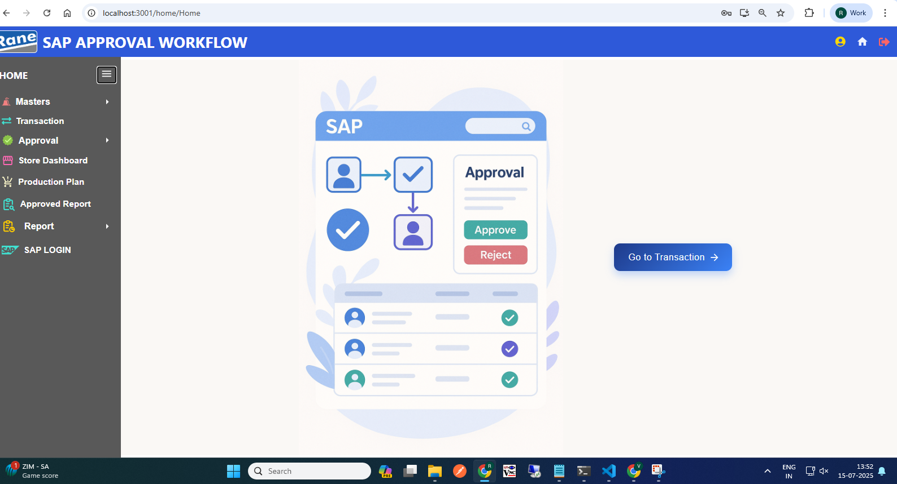
Login Page
Home Page
Click Here, go to the Transaction Dashboard

Slide 3
Material to Material Conversion
( 309 Movement )
User Manual - SAP approval workflow

Slide 4
309 Movement Transaction
Process workflow:
1.Create Request by Users ( PROD / MMD / QAD / MED )
2.Upload Process - Fill in required details
3. Upload Output:
i) New Records, ii) Error Records, iii)Duplicate Records
4. Submit for Approval to Level 1 User.
Level 1 : PLANT FINANCE HEAD
Level 2 : PLANT MRPC
Level 3 : PLANT HEAD
Level 4 : CORP FINANCE HEAD
Level 5 : CORP MRPC
5. Requester Page Visible Data: - Only data uploaded by the logged-in user,
Statuses: Pending, Under Query
6. Download Option: - Filtered by From–To Date & Movement Type
7. Editability: - Enabled only if status is Under Query
8. Resubmit Workflow: - Enabled only if status is Under Query Select rows using checkboxes After making corrections, click Re-submit

Slide 5
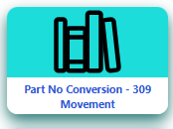
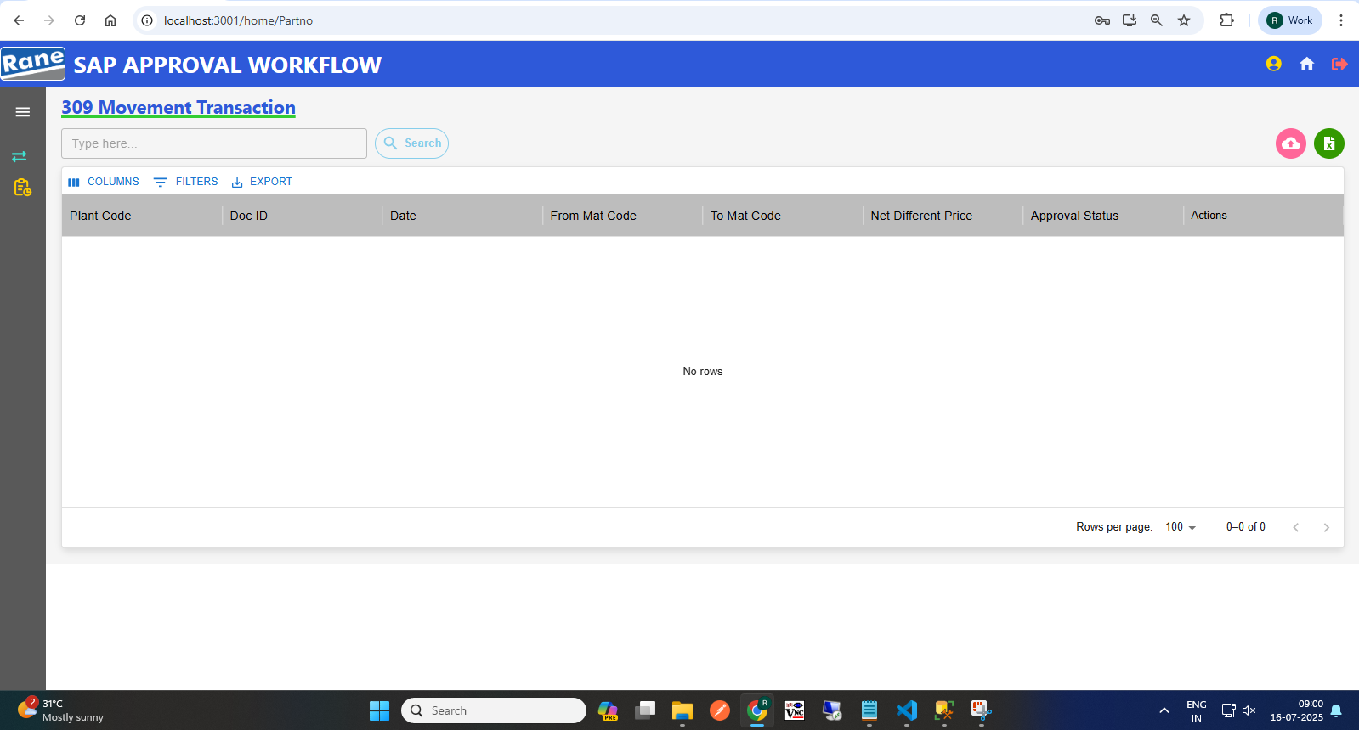
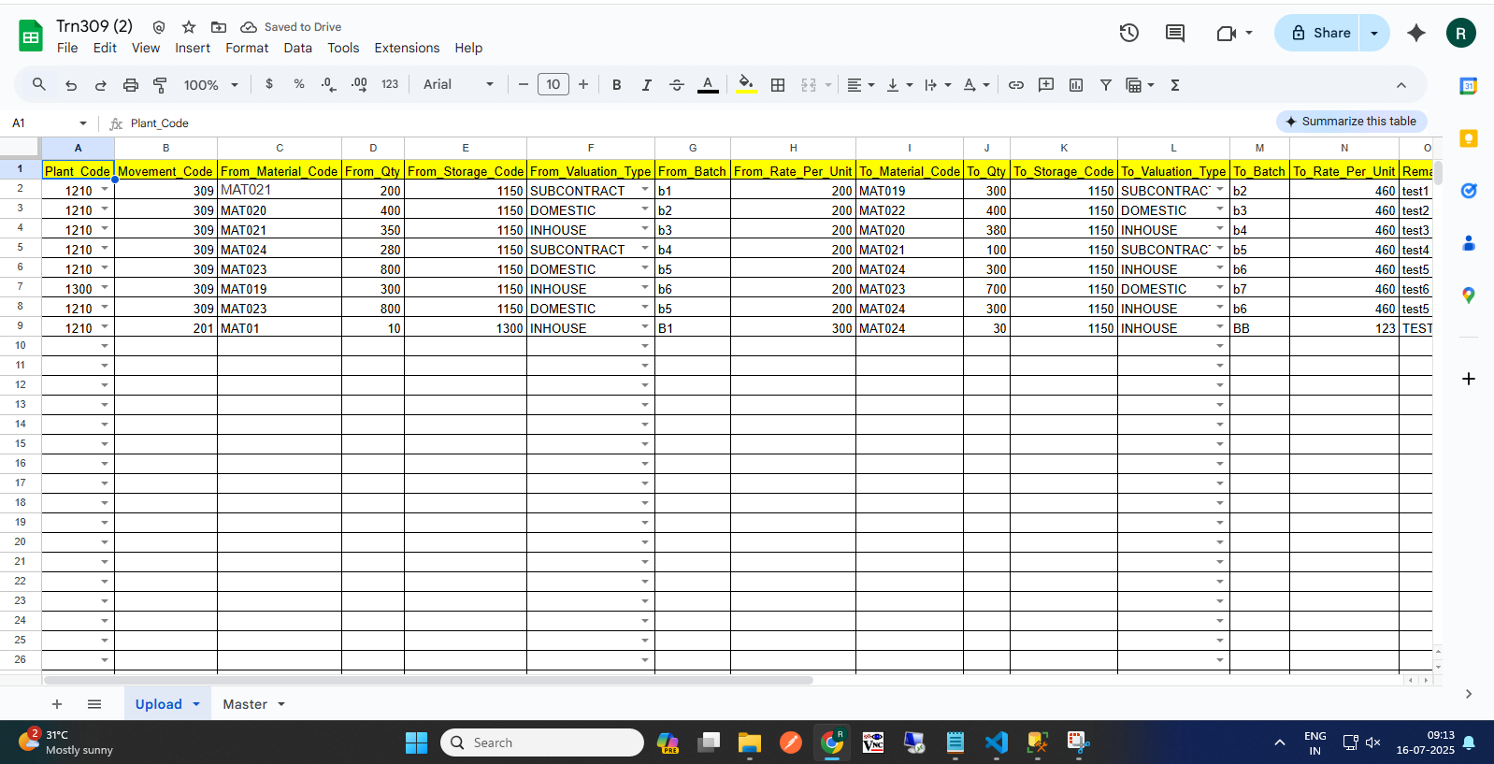
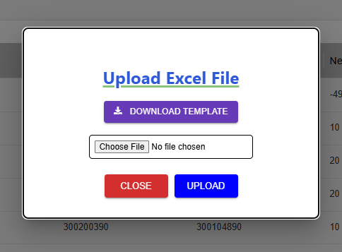
309 Movement Request (Requester)
(1)Transaction Page Navigation
(2)Click to begin a 309 request
Requester Page
Click here
(3) Click here to Download template
(4) Excel Template with Sample Data
(4) Upload
(5) Approval workflow
Request >>> L1 Approver: Plant Finance Head >>> L2 Approver: Plant MRPC >>> L3 Approver: Plant Head >>> L4 Approver: CORP Finance Head >>> L5 Approver: Corp MRPC >>> Send to SAP.

Slide 6
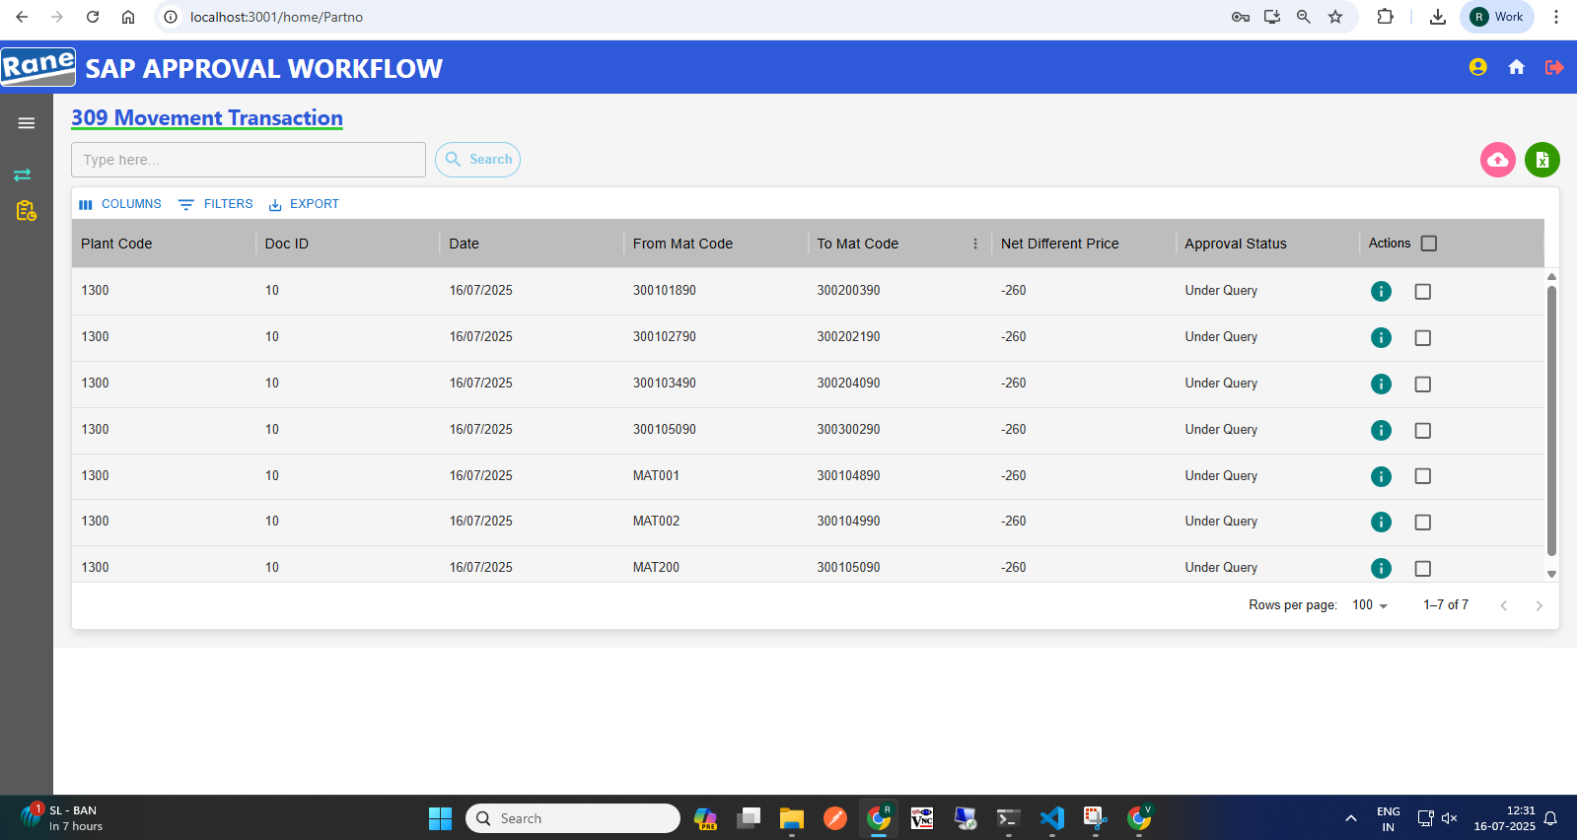
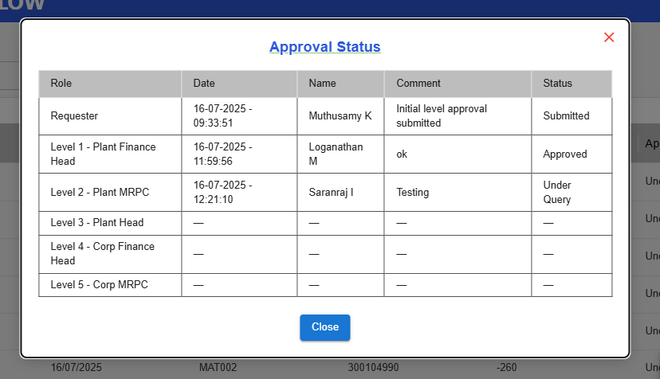
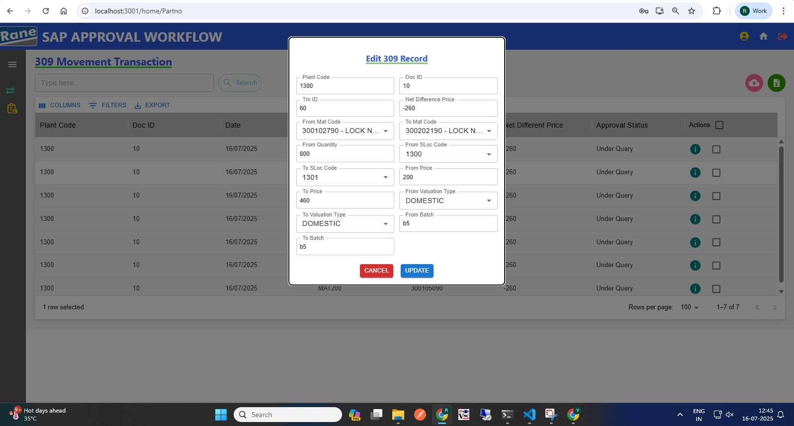
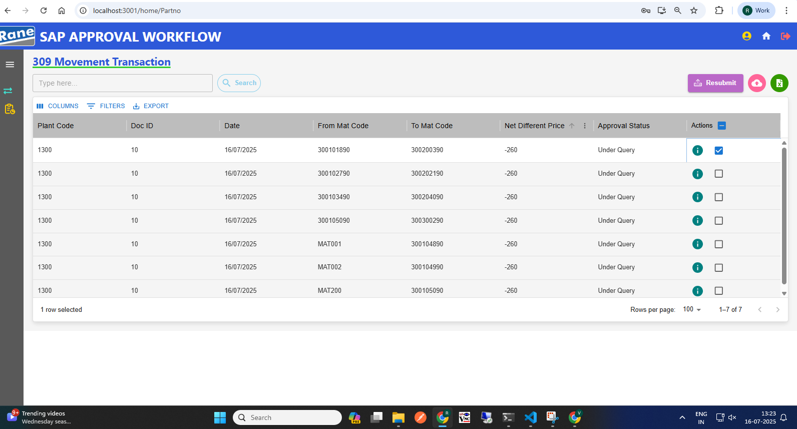
309 Movement: Edit with Status "Under Query" (Requester)
(1) Requester Page After "Under Query" Status
(2) View the Approval Level & Status
(3) Click Row to Edit Row, Then Update
Click here to View status
(4) Select Checkbox, Then Submit Data
Resubmit workflow
Status: Under Query>>> Edit>>> Re-submit>>>Send to Approver.

Slide 7
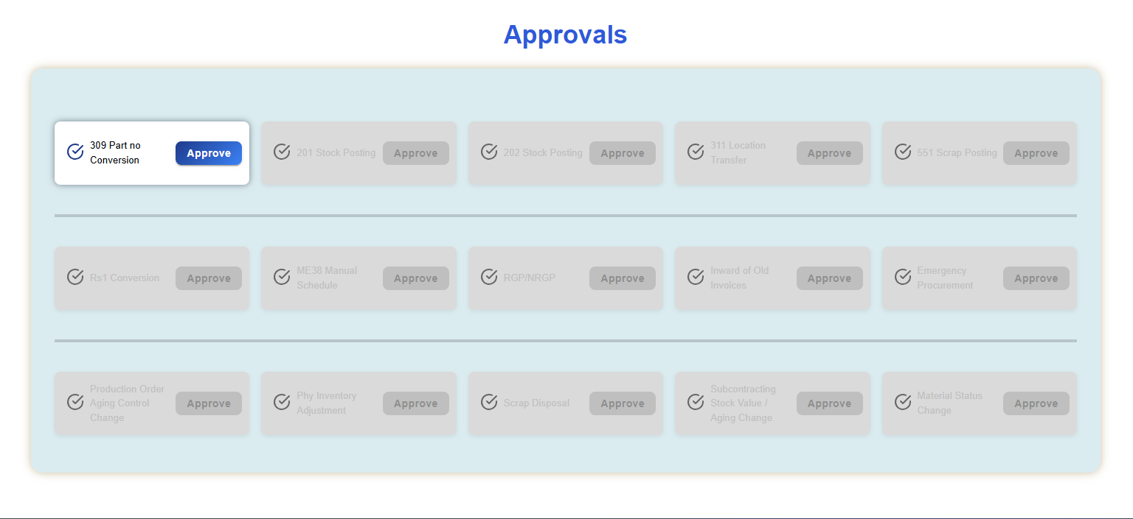
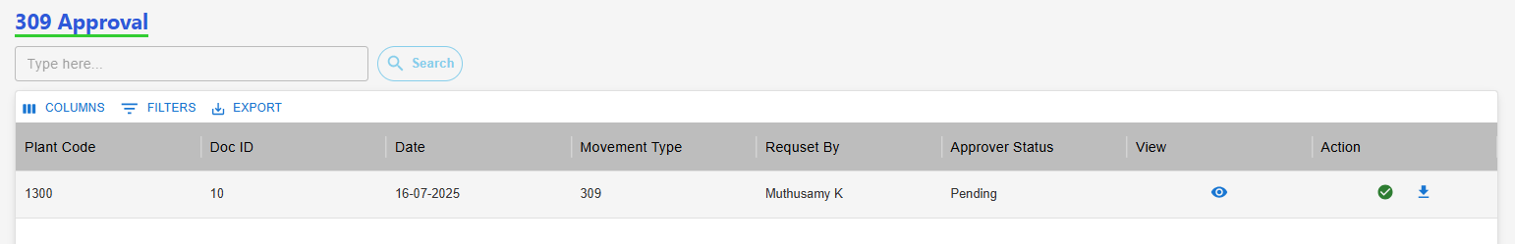
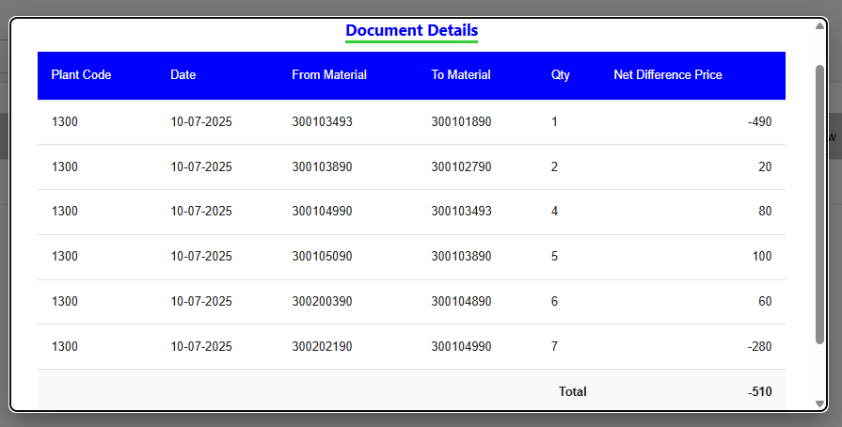
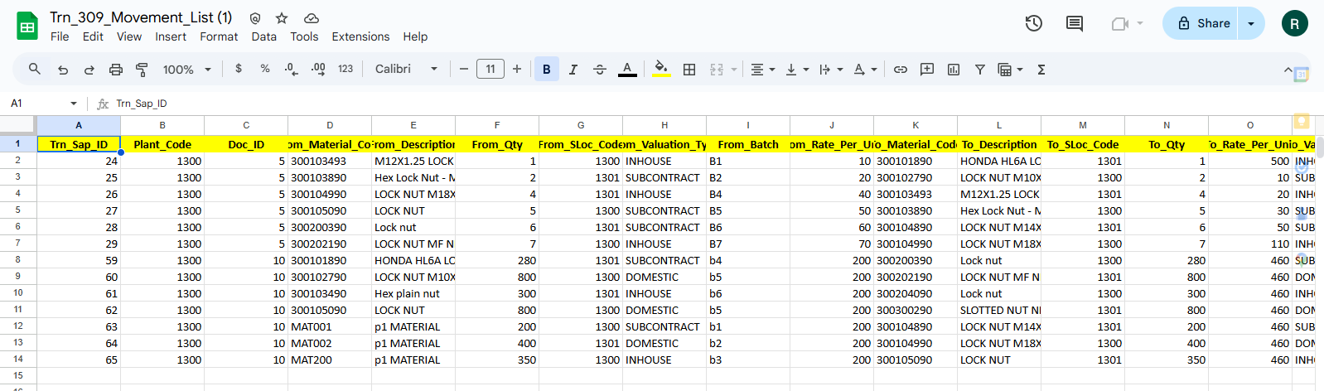
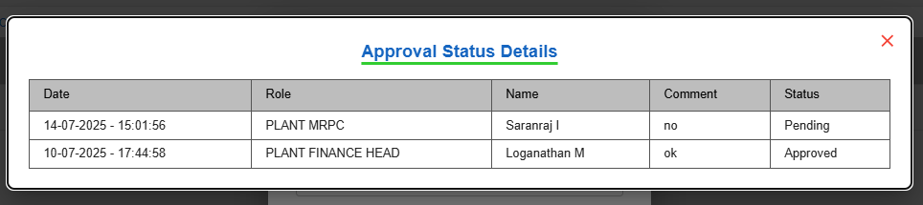
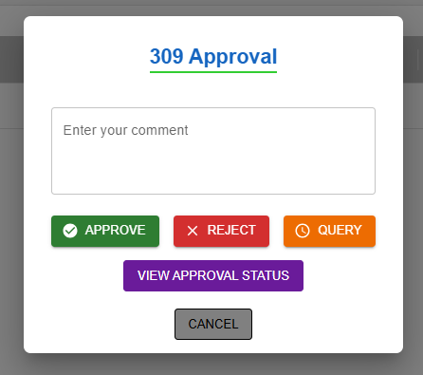
309 Movement Approval (Approver)
Approver Home Page
(2) View Net Difference, Download Records, Take Action
(3) View Details
(4)
(5)
(1) Click here, 309 Approval
(3)
(5) Click Download Icon to View Records
Click "View Approval Status" to See Last Update
(4) Action
Approver Make Action
Approval workflow: Request >>> L1 Approver: Plant Finance Head >>> L2 Approver: Plant MRPC >>> L3 Approver: Plant Head >>> L4 Approver: CORP Finance Head >>> L5 Approver: Corp MRPC

Slide 8
Stock Posting - 201 Mvmt (-)
( 201 Movement )
User Manual - SAP approval workflow

Slide 9
201 Movement Transaction
Process workflow:
1.Create Request by Users ( PROD / MMD / QAD / MED )
2.Upload Process - Fill in required details
3. Upload Output:
i) New Records, ii) Error Records, iii)Duplicate Records
4. Submit for Approval to Level 1 User.
Level 1 : PLANT FINANCE HEAD
Level 2 : PLANT MRPC
Level 3 : PLANT HEAD
Level 4 : CORP FINANCE HEAD
Level 5 : CORP MRPC
5. Requester Page Visible Data: - Only data uploaded by the logged-in user,
Statuses: Pending, Under Query
6. Download Option: - Filtered by From–To Date & Movement Type
7. Editability: - Enabled only if status is Under Query
8. Resubmit Workflow: - Enabled only if status is Under Query Select rows using checkboxes After making corrections, click Resubmit

Slide 10
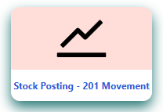
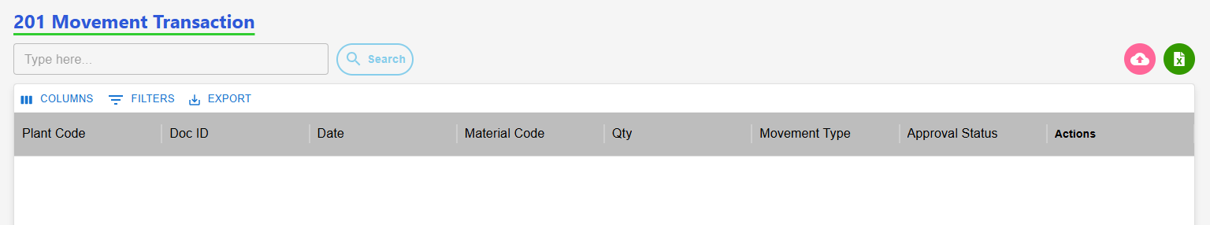
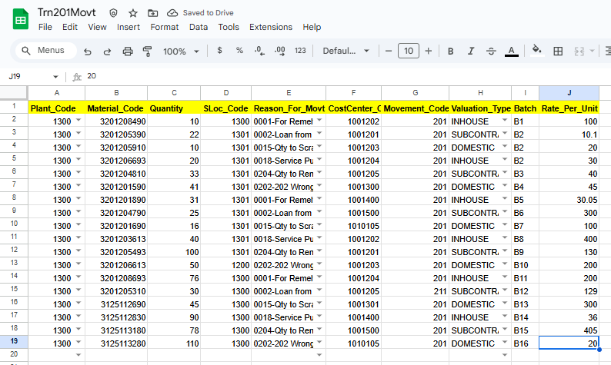
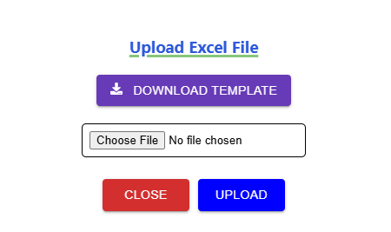
201 Movement Request (Requester)
(1)Transaction Page Navigation
(2)Click to begin a 201 request
201 Requester Page
Click here
(3) Click here to Download template
(4) Excel Template with Sample Data
(4) Upload
(6) Approval workflow
Request >>> L1 Approver: Plant Finance Head >>> L2 Approver: Plant MRPC >>> L3 Approver: Plant Head >>> L4 Approver: CORP Finance Head >>> L5 Approver: Corp MRPC >>> Send to SAP.

Slide 11
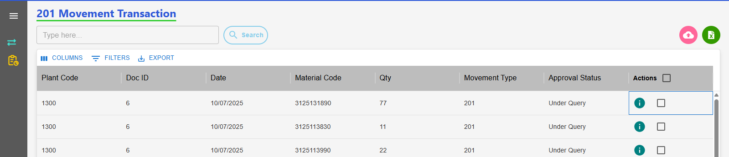
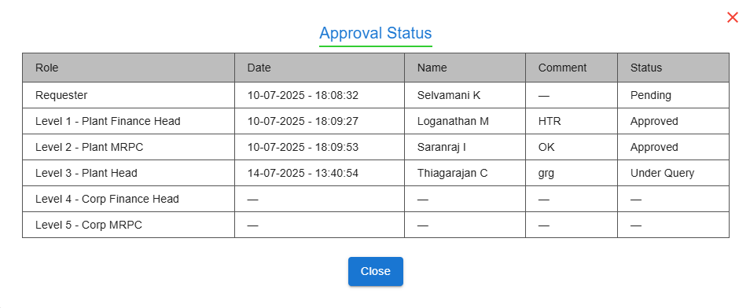
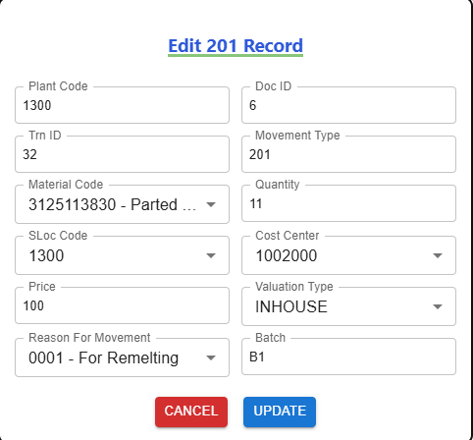
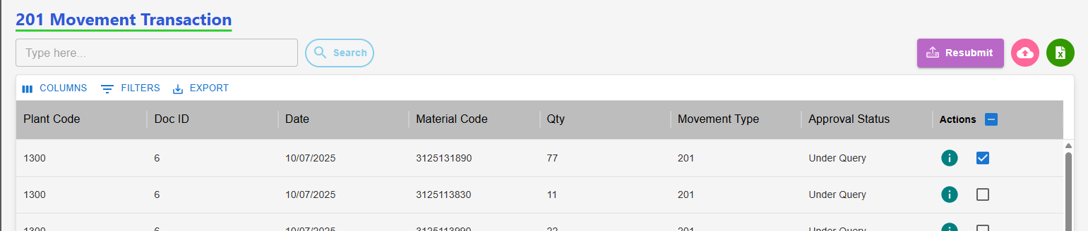
201 Movement: Edit with Status "Under Query" (Requester)
Requester Page After "Under Query" Status
(2) View the Approval Level & Status
(3) Click Row to Edit, Then Update
(1) Click here to View status
(4) Select Checkbox, Then Re-Submit Data
Resubmit workflow
Status: Under Query>>> Edit>>> Re-submit>>>Send to Approver.

Slide 12
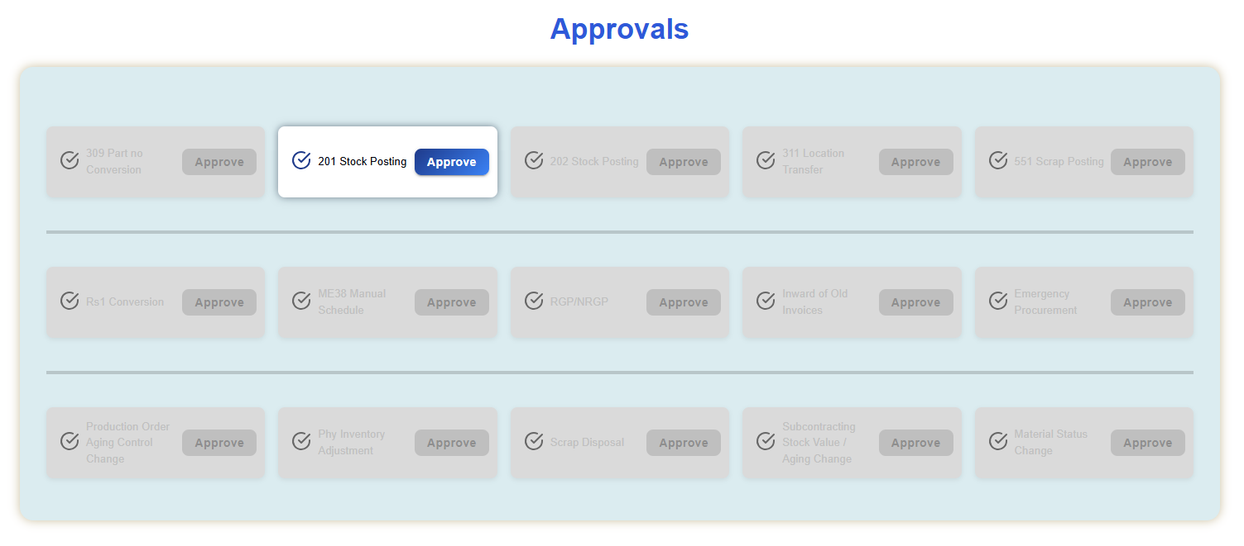
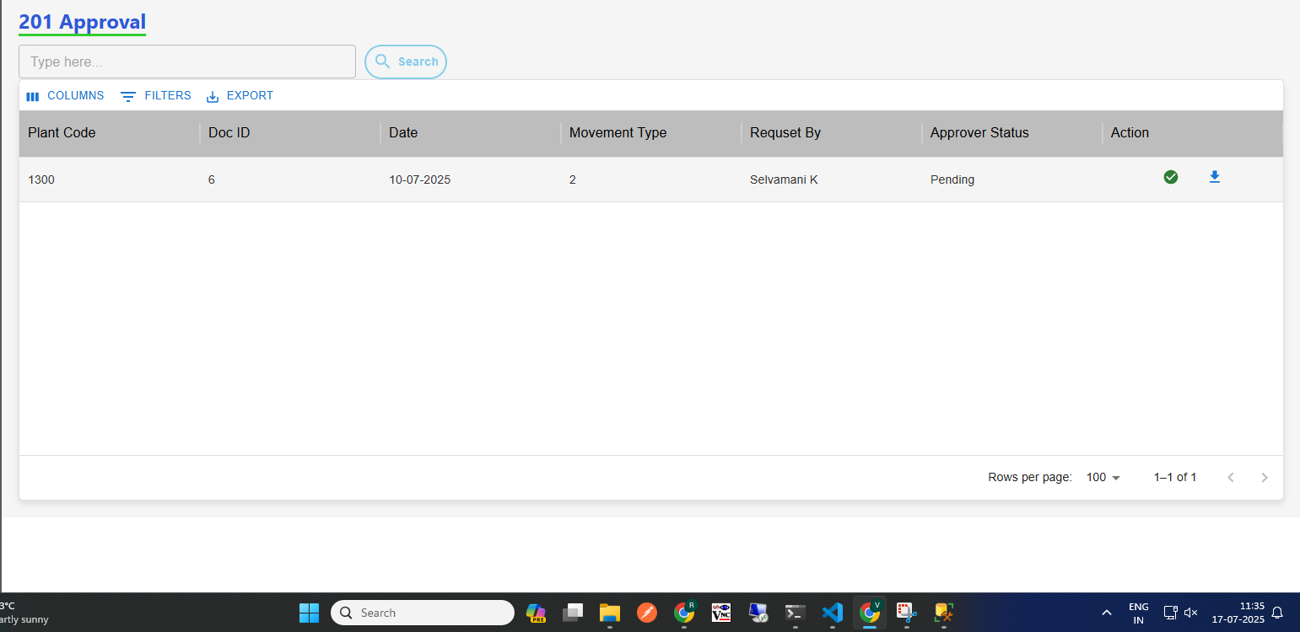
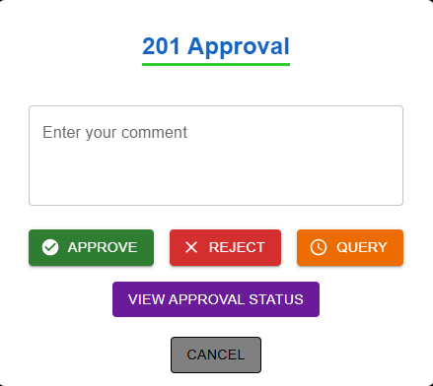
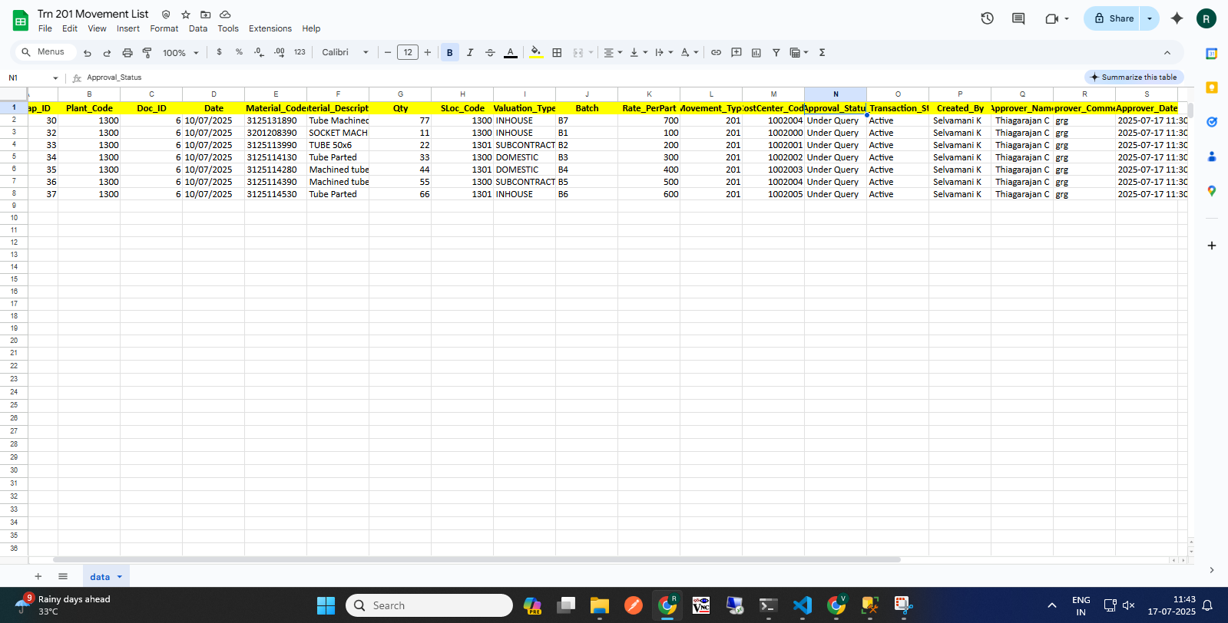
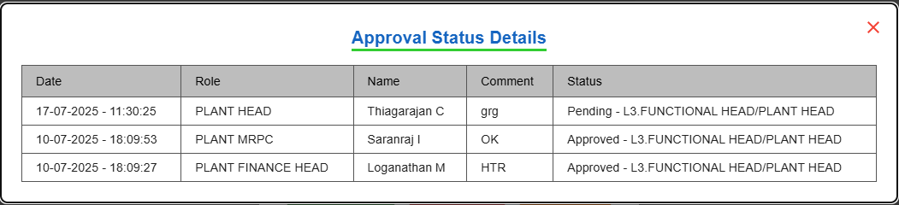
201 Movement Approval (Approver)
Approver Home Page
(2) Approver Page
(3) View Details
(4)
(1) Click here, 201 Approval
(3)
(7)Action
(6) Click Download Icon to View Records
Click "View Approval Status" to See Last Update
Approver Make Action
Approval workflow: Request >>> L1 Approver: Plant Finance Head >>> L2 Approver: Plant MRPC >>> L3 Approver: Plant Head >>> L4 Approver: CORP Finance Head >>> L5 Approver: Corp MRPC

Slide 13
Stock Posting - 202 Mvmt (+)
( 202 Movement )
User Manual - SAP approval workflow

Slide 14
202 Movement Transaction
Process workflow:
1.Create Request by Users ( PROD / MMD / QAD / MED )
2.Upload Process - Fill in required details
3. Upload Output:
i) New Records, ii) Error Records, iii)Duplicate Records
4. Submit for Approval to Level 1 User.
Level 1 : PLANT FINANCE HEAD
Level 2 : PLANT MRPC
Level 3 : PLANT HEAD
Level 4 : CORP FINANCE HEAD
Level 5 : CORP MRPC
5. Requester Page Visible Data: - Only data uploaded by the logged-in user,
Statuses: Pending, Under Query
6. Download Option: - Filtered by From–To Date & Movement Type
7. Editability: - Enabled only if status is Under Query
8. Resubmit Workflow: - Enabled only if status is Under Query Select rows using checkboxes After making corrections, click Resubmit

Slide 15
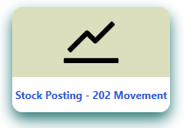
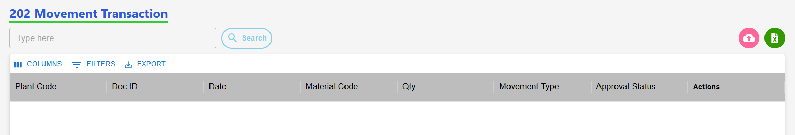
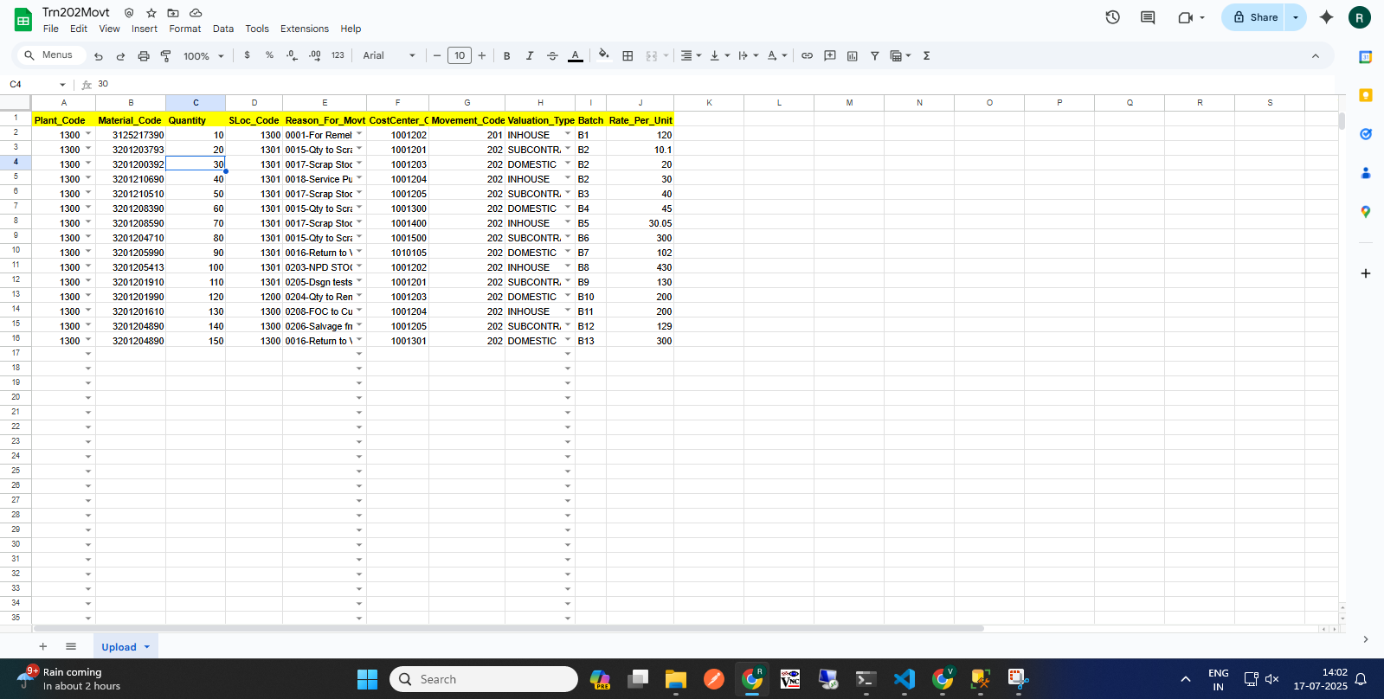
202 Movement Request (Requester)
(1)Transaction Page Navigation
(2)Click to Start a 202 Request
202 Requester Page
Click here
(3) Click here to Download template
(5) Excel Template with Sample Data
(4) Upload
(6) Approval workflow
Request >>> L1 Approver: Plant Finance Head >>> L2 Approver: Plant MRPC >>> L3 Approver: Plant Head >>> L4 Approver: CORP Finance Head >>> L5 Approver: Corp MRPC >>> Send to SAP.

Slide 16
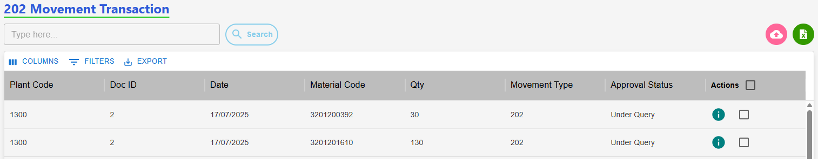
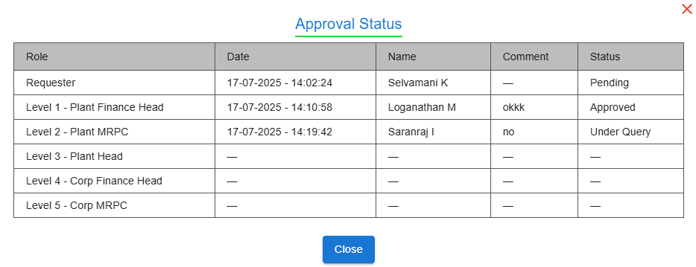
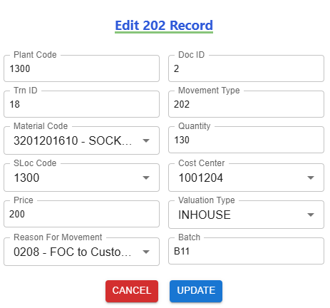
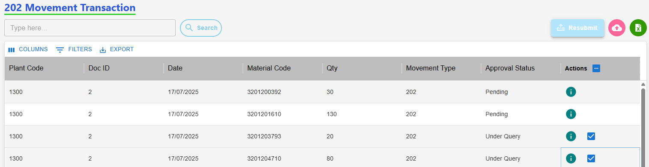
202 Movement: Edit with Status "Under Query" (Requester)
Requester Page After "Under Query" Status
(2) View the Approval Level & Status
(3) Click Row to Edit, Then Update
(1) Click here to View status
(4) Select Checkbox, Then Submit Data
Resubmit workflow
Status: Under Query>>> Edit>>> Re-submit>>>Send to Approver.

Slide 17
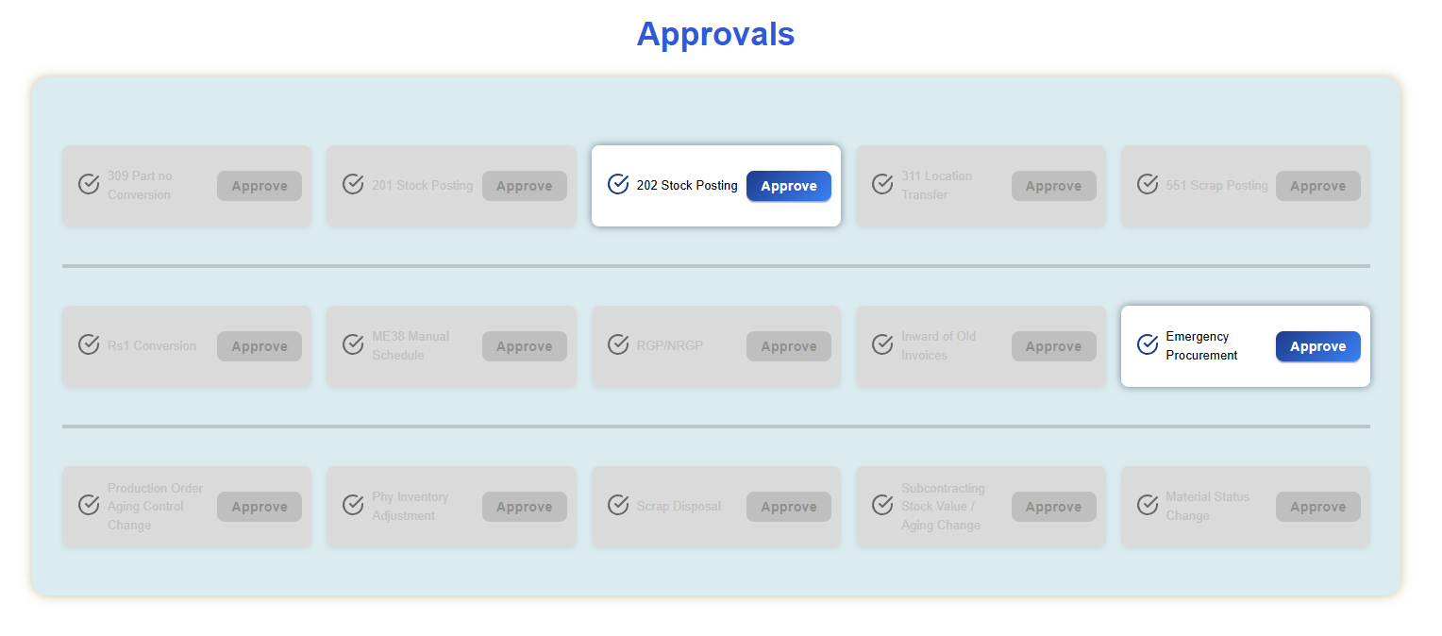
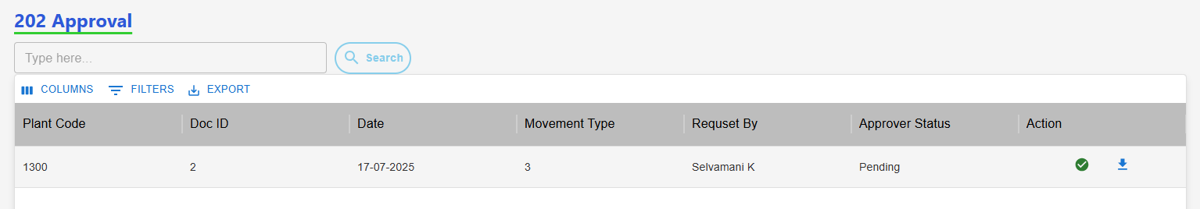
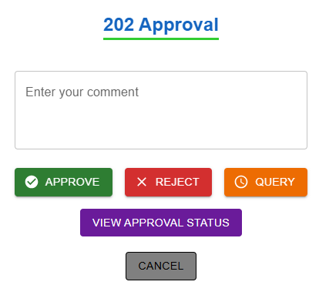
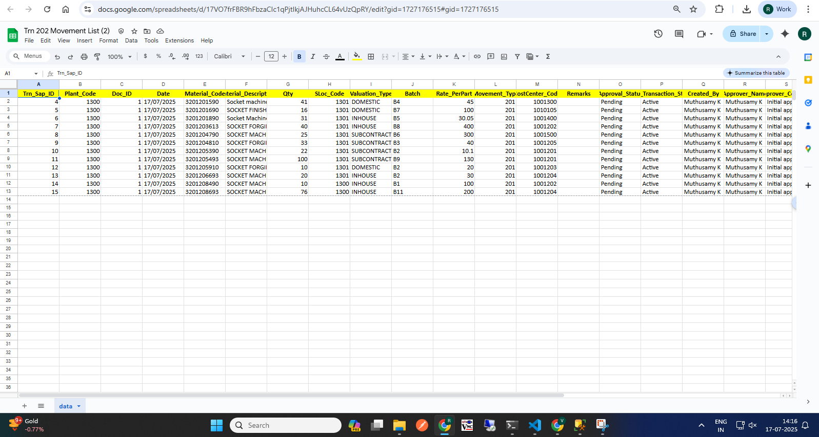
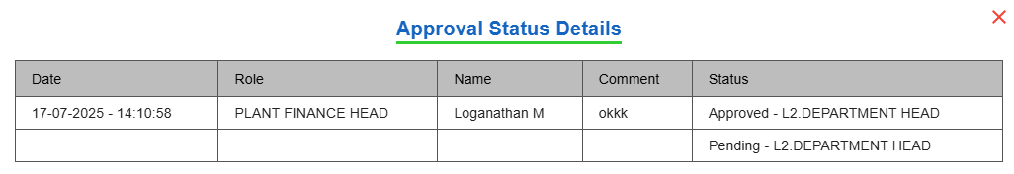
202 Movement Approval (Approver)
Approver Home Page
(2) Approver Page
(3) View Details
(4)
(3)
(5)Action
(4) Click Download Icon to View Records
Click "View Approval Status" to See Last Update
Approver Make Action
Approval workflow: Request >>> L1 Approver: Plant Finance Head >>> L2 Approver: Plant MRPC >>> L3 Approver: Plant Head >>> L4 Approver: CORP Finance Head >>> L5 Approver: Corp MRPC

Slide 18
Scrap Posting
( 551 Movement )
User Manual - SAP approval workflow

Slide 19
551 Movement Transaction
Process workflow:
1.Create Request by Users ( PROD / MMD / QAD / MED )
2.Upload Process - Fill in required details
3. Upload Output:
i) New Records, ii) Error Records, iii)Duplicate Records
4. Submit for Approval to Level 1 User.
Level 1 : PLANT FINANCE HEAD
Level 2 : PLANT MRPC
Level 3 : PLANT HEAD
Level 4 : CORP FINANCE HEAD
Level 5 : BUSINESS HEAD
Level 6 : CORP MRPC
5. Requester Page Visible Data: - Only data uploaded by the logged-in user,
Statuses: Pending, Under Query
6. Download Option: - Filtered by From–To Date & Movement Type
7. Editability: - Enabled only if status is Under Query
8. Resubmit Workflow: - Enabled only if status is Under Query Select rows using checkboxes After making corrections, click Resubmit

Slide 20
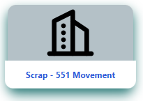
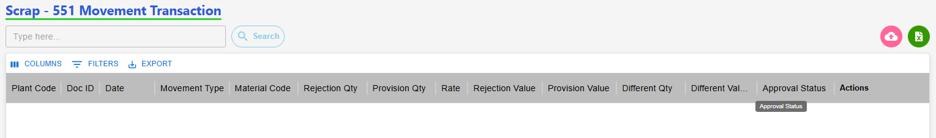
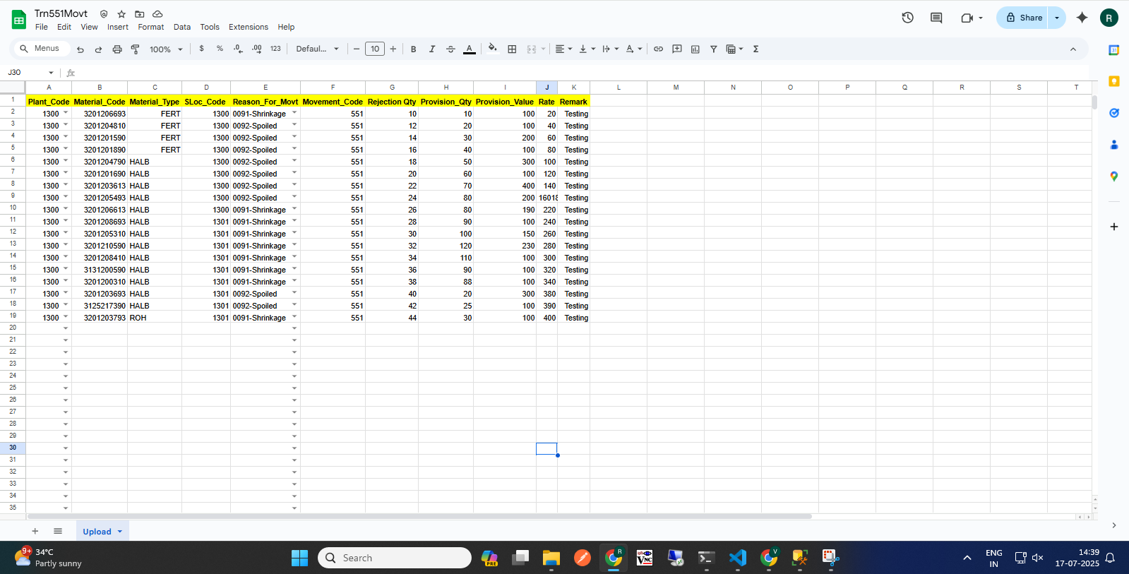
551 Movement Request (Requester)
(1)Transaction Page Navigation
(2)Click to Start a 551 Request
551 Requester Page
Click here
(3) Click here to Download template
(5) Excel Template with Sample Data
(4) Upload
(6) Approval workflow
Request >>> L1 Approver: Plant Finance Head >>> L2 Approver: Plant MRPC >>> L3 Approver: Plant Head >>> L4 Approver: CORP Finance Head >>> L5 Approver: Business Head>>> L6 Approver: Corp MRPC >>> Send to SAP.

Slide 21
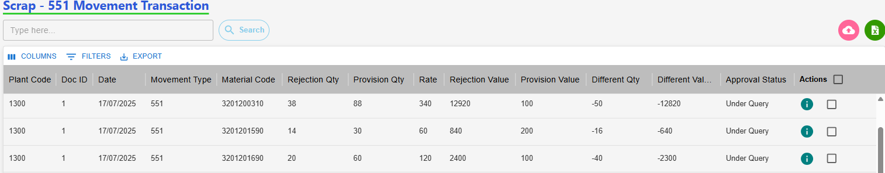
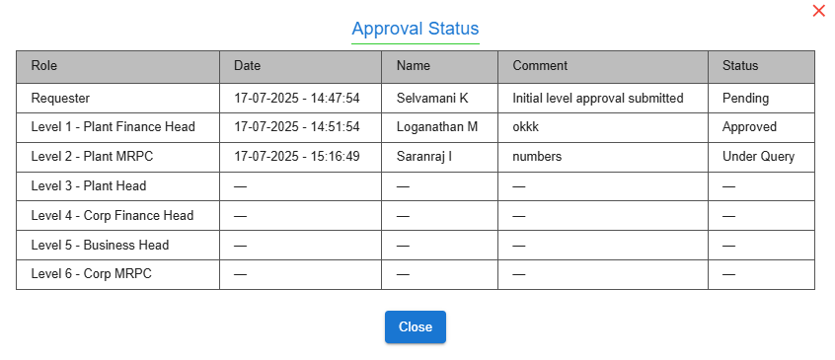
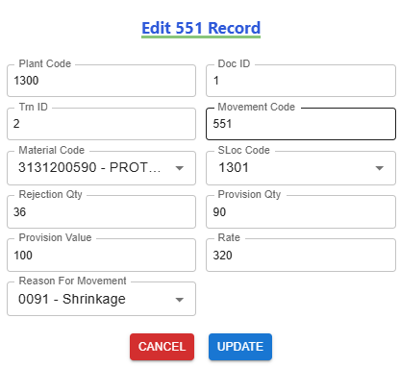
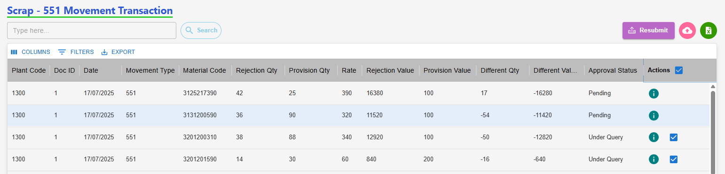
551 Movement: Edit with Status "Under Query" (Requester)
Requester Page After "Under Query" Status
(2) View the Approval Level & Status
(3) Click Row to Edit, Then Update
(1) Click here to View status
(4) Select Checkbox, Then Submit Data
Resubmit workflow
Status: Under Query>>> Edit>>> Re-submit>>>Send to Approver.

Slide 22
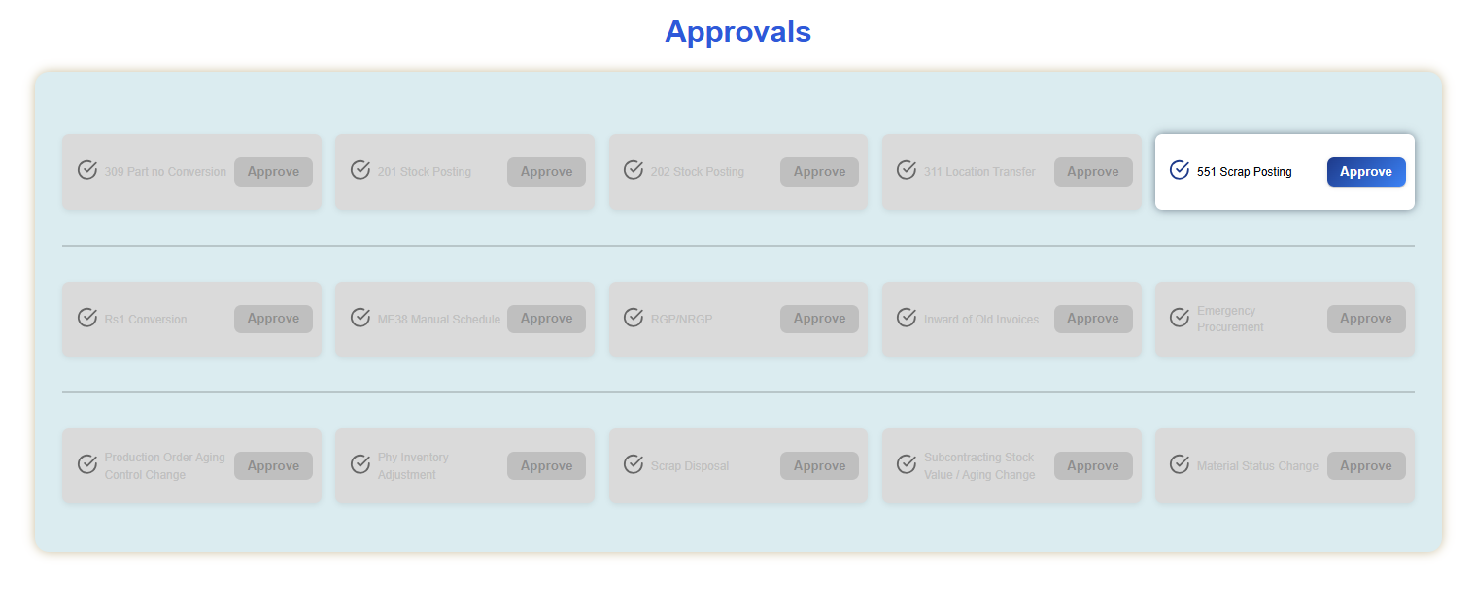
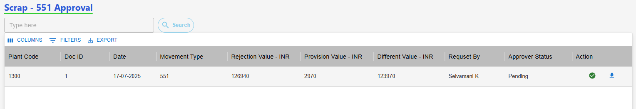


551 Movement Approval (Approver)
Approver Home Page
(2) Approver Page
(3) View Details
(4)
(3)
(5)Action
(4) Click Download Icon to View Records
Click "View Approval Status" to See Last Update
Approver Make Action
Approval workflow: Request >>> L1 Approver: Plant Finance Head >>> L2 Approver: Plant MRPC >>> L3 Approver: Plant Head >>> L4 Approver: CORP Finance Head >>> L5 Approver: Business Head>>> L6 Approver: Corp MRPC

Slide 23
Storage Location Transfer
( 311 Movement )
User Manual - SAP approval workflow

Slide 24
311 Movement Transaction
Process workflow:
1.Create Request by Users ( PROD / MMD / QAD / MED )
2.Upload Process - Fill in required details
3. Upload Output:
i) New Records, ii) Error Records, iii)Duplicate Records
4. Submit for Approval to Level 1 User.
Level 1 : PLANT MRPC
5. Requester Page Visible Data: - Only data uploaded by the logged-in user,
Statuses: Pending, Under Query
6. Download Option: - Filtered by From–To Date & Movement Type
7. Editability: - Enabled only if status is Under Query
8. Resubmit Workflow: - Enabled only if status is Under Query Select rows using checkboxes After making corrections, click Resubmit

Slide 25



311 Movement Request (Requester)
(1)Transaction Page Navigation
(2)Click to Start a 311 Request
311 Requester Page
Click here
(3) Click here to Download template
(5) Excel Template with Sample Data
(4) Upload
(6) Approval workflow
Request >>> L1 Approver: Plant MRPC >>> Send to SAP.

Slide 26




551 Movement: Edit with Status "Under Query" (Requester)
Requester Page After "Under Query" Status
(2) View the Approval Level & Status
(3) Click Row to Edit, Then Update
(1) Click here to View status
(4) Select Checkbox, Then Submit Data
Resubmit workflow
Status: Under Query>>> Edit>>> Re-submit>>>Send to Approver.

Slide 27





551 Movement Approval (Approver)
Approver Home Page
(2) Approver Page
(3) View Details
(4)
(3)
(5)Action
(4) Click Download Icon to View Records
Click "View Approval Status" to See Last Update
Approver Make Action
Approval workflow: Request >>> L1 Approver: Plant MRPC

Slide 28
Conversion Rs1
( RS.1 Movement )
User Manual - SAP approval workflow

Slide 29
Rs.1 Movement Transaction
Process workflow:
1.Create Request by Users ( PROD / MMD / QAD / MED )
2.Upload Process - Fill in required details
3. Upload Output:
i) New Records, ii) Error Records, iii)Duplicate Records
4. Submit for Approval to Level 1 User.
Level 1 : PLANT FINANCE HEAD
Level 2 : PLANT HEAD
Level 3 : CORP FINANCE HEAD
Level 4 : BUSINESS HEAD
5. Requester Page Visible Data: - Only data uploaded by the logged-in user,
Statuses: Pending, Under Query
6. Download Option: - Filtered by From–To Date & Movement Type
7. Editability: - Enabled only if status is Under Query
8. Resubmit Workflow: - Enabled only if status is Under Query Select rows using checkboxes After making corrections, click Resubmit

Slide 30



Rs.1 Movement Request (Requester)
(1)Transaction Page Navigation
(2)Click to Start a Rs.1 Request
Rs.1 Requester Page
Click here
(3) Click here to Download template
(5) Excel Template with Sample Data
(4) Upload
(6) Approval workflow
Request >>> L1 Approver: Plant Finance Head >>> L2 Approver: Plant Head >>> L3 Approver: CORP Finance Head >>> L4 Approver: Business Head >>> Send to SAP.

Slide 31



Rs.1 Movement: Edit with Status "Under Query" (Requester)
Requester Page After "Under Query" Status
(2) View the Approval Level & Status
(3) Click Row to Edit, Then Update
(1) Click here to View status
(4) Select Checkbox, Then Submit Data
Resubmit workflow
Status: Under Query>>> Edit>>> Re-submit>>>Send to Approver.

Slide 32





Rs.1 Movement Approval (Approver)
Approver Home Page
(2) Approver Page
(3) View Details
(34)
(3)
(5)Action
(4) Click Download Icon to View Records
Click "View Approval Status" to See Last Update
Approver Make Action
Approval workflow: Request >>> L1 Approver: Plant Finance Head >>> L2 Approver: Plant Head >>> L3 Approver: CORP Finance Head >>> L4 Approver: Business Head

Slide 33
Inward Old Invoice
( Purchase)
User Manual - SAP approval workflow

Slide 34
Inward of Old Invoices (Purchase) Movement Transaction
Process For Purchase workflow:
1.Create Request by Users ( PROD / MMD / QAD / MED )
2.Add Process - Fill in required details
3. Submit for Approval to Level 1 User
Purchase Approval Workflow
Case (i): If invoice date is less than 1 year: Level 1: Corp MRPC approves → Send to SAP
Case (ii): If invoice date is more than 1 year: Level 1: Corp MRPC reviews and sends to: Level 2: Corp Finance Head or Corp MMD Head. If approved → Send to SAP
4. Requester Page Visible Data: - Only data uploaded by the logged-in user,
Statuses: Waiting, New, Rejected
5. Download Option: - Filtered by From–To Date
6. Editability: - Enabled only if status is Waiting, New, Rejected
Select rows using Edit After making corrections, Resubmit

Slide 35



Inward of Old Invoices Purchase Request (Requester)
(1)Transaction Page Navigation
(2)Click to Start a Purchase Request
Purchase Requester Page
(3)Click here to add Purchase
Click here
(4) Add
Approval workflow: Request >>> Follows Case (i) or Case (ii) based on Invoice Date:
Case (i): Invoice < 1 Year. Level 1: Corp MRPC >>> Send to SAP
Case (ii): Invoice > 1 Year. Level 1: Corp MRPC >>> Level 2: Corp Finance Head or Corp MMD Head>>> Send to SAP

Slide 36





Inward of Old Invoices Purchase Resubmit (Requester)
(2)Click to Start a 201 Request
(2)Clic(2)Click to Start a 201 Request
k to Start a 201 Request
(1)Requester Page After Rejected
(2) View the Approval Level & Status
(3)Click Row to Edit Purchase
(4)
(3)
(5)After editing, add a comment & Resubmit
(4)Click Here to Resubmit
Approval workflow: Request >>> Follows Case (i) or Case (ii) based on Invoice Date:
Case (i): Invoice < 1 Year. Level 1: Corp MRPC >>> Send to SAP
Case (ii): Invoice > 1 Year. Level 1: Corp MRPC >>> Level 2: Corp Finance Head or Corp MMD Head>>> Send to SAP

Slide 37




Inward of Old Invoices Purchase Approval (Approver)
Approver Home Page
(2) Approver Page
(3) View Details
(3)
(4)
(4)Action
Approver workflow : Case (i): Invoice < 1 Year. Level 1: Corp MRPC >>> Send to SAP
Case (ii): Invoice > 1 Year. Level 1: Corp MRPC >>> Level 2: Corp Finance Head or Corp MMD Head >>> Send to SAP

Slide 38
Inward Old Invoice
( Service )
User Manual - SAP approval workflow

Slide 39
Inward of Old Invoices (Service) Movement Transaction
Process For Service workflow:
1.Create Request by Users ( PROD / MMD / QAD / MED )
2.Add Process - Fill in required details
3.Submit for Approval to Level 1 User.
Level 1 : PLANT FINANCE HEAD
Level 2 : CORP MRPC
Level 3 : CORP FINANCE HEAD
5. Requester Page Visible Data: - Only data uploaded by the logged-in user,
Statuses: Waiting, New, Rejected
6. Download Option: - Filtered by From–To Date
7. Editability: - Enabled only if status is Waiting, New, Rejected
Select rows using Edit After making corrections, Resubmit

Slide 40


Inward of Old Invoices Service Request (Requester)
(1)Transaction Page Navigation
(2)Click to Start a Service Request
Service Requester Page
Click here
Click here to add Service
(4) Add Service
(5) Approval workflow
Request >>> L1 Approver: Plant Finance Head >>> L2 Approver: CORP MRPC >>> L3 Approver: CORP Finance Head >>> Send to SAP.

Slide 41



Inward of Old Invoices Purchase Resubmit (Requester)
(1)Requester Page After Rejected
(2) View the Approval Level & Status
(3)Click Row to Edit Purchase
(4)
(3)
(5)After editing, add a comment & Resubmit
(4)Click Here to Resubmit
(6) Approval workflow
Request >>> L1 Approver: Plant Finance Head >>> L2 Approver: CORP MRPC >>> L3 Approver: CORP Finance Head >>> Send to SAP.

Slide 42



Inward of Old Invoices Service Movement Transaction Approval (Approver)
(1)Approver Home Page
(2) View Records
(3) Action
(3)
Approver Make Action
Approval workflow: Request >>> L1 Approver: Plant Finance Head >>> L2 Approver: CORP MRPC >>> L3 Approver: CORP Finance Head.

Slide 43
Emergency Procurement
( Emergency )
User Manual - SAP approval workflow

Slide 44
Emergency Procurement Movement Transaction
Process For Purchase workflow:
1.Create Request by Users ( PROD / MMD / QAD / MED )
2.Add Process - Fill in required details
3.Submit for Approval to Level 1 User.
Level 1 : PLANT MRPC
Level 2 : PLANT FINANCE HEAD
Level 3 : PLANT HEAD (after 3 approval finished mail trigger to the gate office)
5. Requester Page Visible Data: - Only data uploaded by the logged-in user,
Statuses: Waiting, New, Rejected
6. Download Option: - Filtered by From–To Date
7. Editability: - Enabled only if status is Waiting, New, Rejected
Select rows using Edit After making corrections, Resubmit
Purchase Order Insert Later (If Not Update PO Mail Trigger TO Approval’s)

Slide 45



Emergency Procurement Request (Requester)
(1)Transaction Page Navigation
(2)Click to Start a Service Request
Service Requester Page
Click here
Click here to add Service
(4) Add Service
(6) Approval workflow
Request >>> L1 Approver: Plant MRPC >>> L2 Approver: Plant Finance Head >>> L3 Approver: Plant Head.

Slide 46



Emergency Procurement Movement Transaction Resubmit (Requester)
(1)Requester Page After Rejected
(2) View the Approval Level & Status
(3)Click Row to Edit Purchase
(4)
(3)
(5)After editing, add a comment & Resubmit
(4)Click Here to Resubmit
(6) Approval workflow
Request >>> L1 Approver: Plant MRPC >>> L2 Approver: Plant Finance Head >>> L3 Approver: Plant Head.

Slide 47


Emergency Procurement Movement Transaction Approval (Approver)
(1)Approver Home Page
(2) View Records
(3) Action
(3)
(4) Approver Make Action
Approval workflow: Request >>> L1 Approver: Plant MRPC >>> L2 Approver: Plant Finance Head >>> L3 Approver: Plant Head.

Slide 48
Thank you

